Slide 1

CHNA 2016
Peace Island Medical Center
Refresh & Align

Slide 2
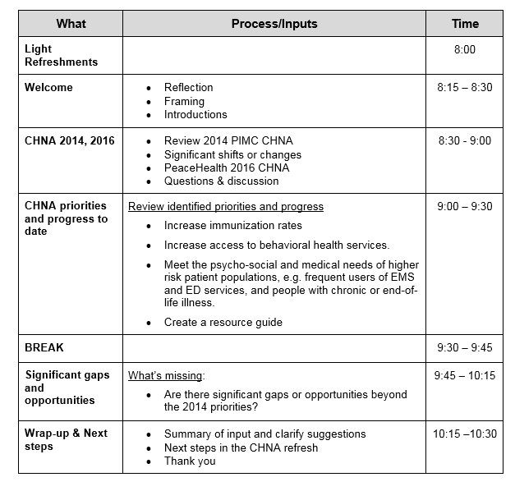
AGENDA

Slide 3

Framing the conversation

Slide 4
What is a CHNA?
A systematic process involving the community, to identify and analyze community health needs in order to prioritize, plan and act on unmet community need.
-Catholic Health Association
Community involvement
Focus on vulnerable populations
Emphasis on action

Slide 5
Timeline for PeaceHealth CHNA, 2016
Jan - March April May June
Prior CHNA review
2016 Design
Data Collection
Key Informant Interviews
6 – 8 in each
community
Community Stakeholder Convening
1 in each community
Board Approval
OUTCOMES
Affirm needs
Identify gaps
Affirm needs
Identify possible evidence based strategies
Three year plan/ annual updates
Share CHNA
Dashboards

Slide 6
Current Situation & Plan
PeaceHealth hospitals conducted CHNA in 2013 and are now completing CHNAs for the second cycle
PIMC completed its CHNA in 2015 (Later CHNA allowed for hospitals built or acquired in the period)
Plan is to affirm/update current CHNA priorities
Align structure CHNA structure with PeaceHealth approach
Strengthen implementation plan
Work with Health Department for robust assessment in 2018/19

Slide 7
CHNA Identified Needs, 2012/13
COMMON ACROSS PEACEHEALTH COMMUNITIES | OTHER RE-OCCURRING ISSUES
Insurance coverage Access to community mental health and substance abuse services Care coordination for patients who are high utilizers of services | Tobacco and obesity rates among subpopulations Access to primary care Adverse Childhood Events (ACEs) PeaceHealth cultural competency Support for aging population

Slide 8
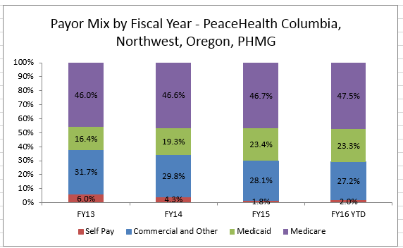
Shift from “Self Pay” to Insured

Slide 9
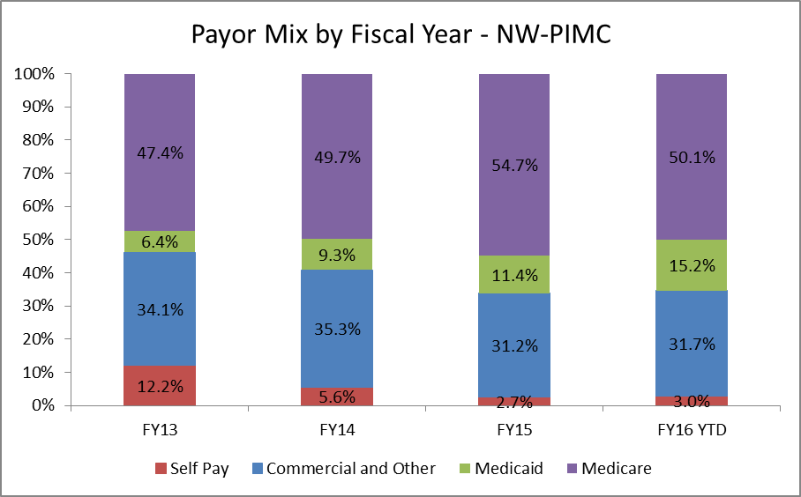
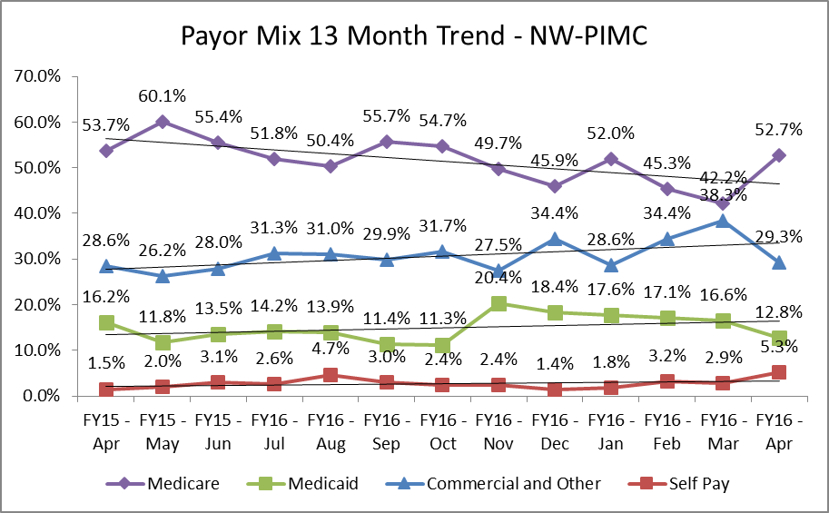
Acute Payer Mix
Notes:
Updated 5-12

Slide 10
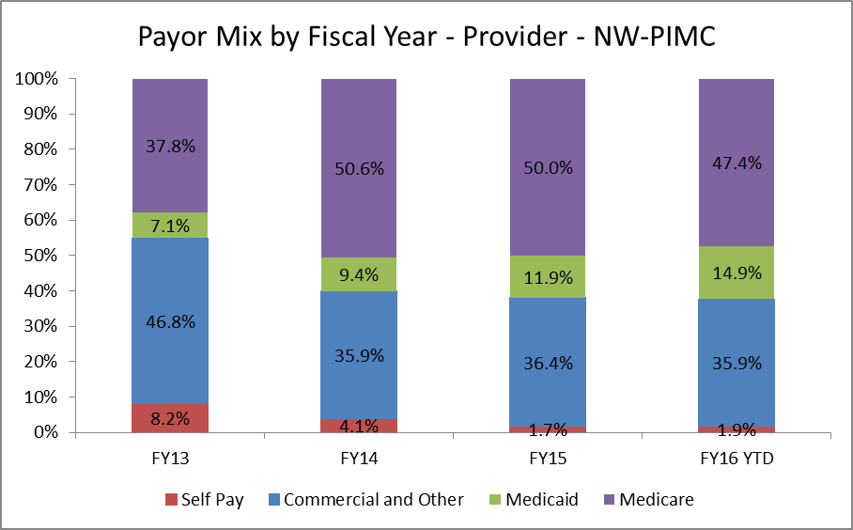
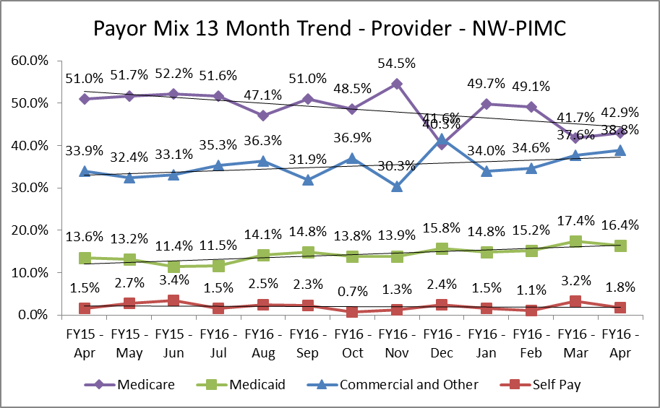
Provider Payer Mix
Notes:
Updated 5-12

Slide 11
High-level Review of Data Identified in 2014 Assessment, and Updates Where Available

Slide 12
Data Sources:
Robert Wood Johnson Foundation County Health Rankings
Washington State Department of Health: Chronic Disease Profiles; Vital Statistics; Immunization Program; Healthy Youth Survey
Washington State Office of the Superintendent of Instruction
Enroll America
Community Commons
Feeding America
University of Washington Alcohol and Drug Abuse Institute
US Census

Slide 13
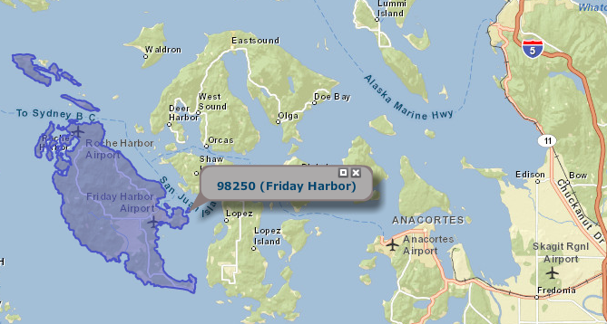
Consistent with the Hospital District definition, the service area is defined as San Juan Island (98250), PHD#1 (includes all of San Juan Island, as well as Stuart, Henry, John’s, Spieden and Pearl Islands). The remainder of the County is considered a secondary service area.
The data used for CHNAs is typically collected at the County level, but some data is available at the individual zip code level.
Where available, we have used SJI data, where not, we report the County data.

Slide 14
SJI’s median income, its high school graduation rate and its poverty rate significantly better than the State at large.
SJI rate of foreign born residents and rate of a language other than English spoken at home is about one-half the State rate.
Area | Population | Foreign Born | Language other than English spoken at home | Per Capita Income | Median Household Income | Percent High School Graduate or Higher | Poverty Rate*
Friday Harbor (98250) | 7,664 | 7.4% | 8.5% | $ 40,775 | $ 58,227 | 93.9% | 6.1%
San Juan County | 15,769 | 6.9% | 7.1% | $ 38,636 | $ 52,712 | 94.5% | 7.6%
Washington | 6,724,540 | 13.0% | 18.2% | $ 30,661 | $ 59,374 | 89.8% | 8.4%
Source: 2010 U.S. Census Bureau, 2008-2012 American Community Survey
*Poverty Rate: % of families whose income in the past 12 month is below the poverty level

Slide 15
San Juan Island has a lower rate of adults that smoke and that are obese. However, the County sees a higher rate of excessive drinking.
Health Behaviors
 | San Juan County | Washington | Top US Performers*
Adult smoking | 13% | 16% | 14%
Adult obesity | 19% | 28% | 25%
Physical inactivity | 13% | 19% | 21%
Excessive drinking | 21% | 17% | 10%
Teen birth rate (per 1,000 female population age 15-19) | 14 | 30 | 20
Source: County Health Rankings, San Juan County 2014, *90th percentile, i,.e., only 10% are better
11
Notes:
San Juan County adults are less likely to engage in some risk behaviors like smoking and physical inactivity, and are less likely to be obese than other groups. But San Juan County adults have high rates of ‘excessive drinking,’ defined as binge drinking or heavy drinking (1 drink per day for women, 2 for men).
The teen birth rate is lower than most other areas in Washington and the US, and tends to correlate with higher-income and higher-education areas like San Juan County.

Slide 16
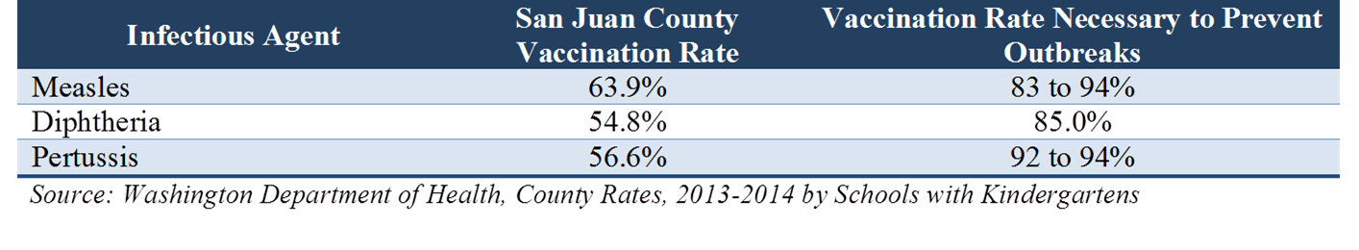
From 2014 CHNA: Low Immunization Rates
Needs/ Quantitative

Slide 17
Other Findings from 2014:
San Juan County has the 2nd oldest median age of any Washington County.
Census data shows a growing Hispanic population on San Juan Island, and the numbers could be understated
  8% of San Juan Island’s population is Hispanic. The Hispanic population grew rapidly between 2000 and 2010 (162%) and is expected to grow another 25% in the next 5 years.
While performing better on many of the social determinants of health, at the time of the CHNA, 19% of the under 65 is uninsured (this has since improved ).

Slide 18
Updates to 2014 CHNA Health Status data show dramatic improvement in uninsured.
 | 2013/2014 | 2015/2016
Uninsured adults | 21% | 7.8%
PCPs | 1,132:1 | 1,130:1
Preventable hospital stays | 22 | 15
Diabetic screening | 84% | 88%
Mammography screening | 72% | 62%
Leading Causes of Death | 2012 | 2012-2014
Cancer | 125.3 | 115.4
Heart disease | 123.3 | 130.9
Alzheimer’s | 41.0 | 41.0
Chronic lung disease | 35.7 | 24.9
Unintentional injury | 6* | 42.9
Adult Health Behaviors | 2014 | 2016
Adult smoking | 13% | 12%**
Adult obesity | 19% | 18%
Physical inactivity | 13% | 14%
Excessive drinking | 21% | 18%**
* Rate of unintentional injury not available for San Juan because low numbers- 6 represents total unintentional injury deaths in 2012
**methods changed/cannot compare to earlier years.
Sources: 2016 County Health Rankings, 2014 WA Healthy Youth Survey, Personal Communication with WA DOH (2012-2014 death rates)
Notes:
This table is a comparison of some measures we collected at the 2014 CHNA with more recent data.
Most of the data has remained the same, except for the change in the rate of uninsured adults. This dramatic improvement is due to the Affordable Care Act, and you can see that the rate of preventable hospital stays has fallen as well, possibly due to better primary care access among adults.
So in clinical care, we’ve really improved dramatically since 2012/2013, when most of these 2014 data were collected.

Slide 19
Healthy Youth Survey shows increase in use of cigarettes, alcohol and drugs. Also shows large increase in depression.
Teen birth rate (per 1,000 female pop. ages 15-19) | 14 | 15
Youth Health Behavior | 2012 | 2014
10th grade cigarette use in last 30 days** | 11% | 19.3% (CI: +/- 8.4)
10th grade alcohol use in last 30 days** | 22% | 35.6% (+/- 10.3)
8th grade marijuana use in last 30 days | 23% | 8th grade no data 2014
12th grade illegal drug use in last 30 days | 8% | 9.8% (CI: +/- 6.6)
10th grade depressed period of 2 weeks or more | 27% (CI: +/- 9.1) | 45.5% (CI: +/- 10.6)
8th grade obese or overweight | 19% | 8th grade no data 2014
8th grade considering attempting suicide in past year | 14% | 8th grade no data 2014
10th grade had sexual intercourse | 33% | 26.5% (CI: +/- 15.6)
**2014 rate in San Juan County significantly higher than WA state
Sources: WA Healthy Youth Survey,
Notes:
These data come from the yearly Washington Healthy Youth Survey.
None of the youth health behavior measures have significantly changed from 2012 to 2014. Because the sample size in San Juan County is very small, there’s a wide range of possible true measurements in the survey. For example, even though cigarette use looks to have jumped from 11% to 19%, the confidence interval of 8.4 crosses back down to equal the 2012 rate of 11%, and up to 27.4%. So from this, we can conclude that the cigarette use in 2014 is not significantly different from cigarette use in 2012. And if we look at depression as measured in 2012, the confidence interval was 9.1, which crosses the range of possible true measures for 2014. So even though the numbers look very different, statistically we cannot say they are different.
In summary, none of the the health factors among San Juan youth have changed since 2012.
What is notable from these numbers is that San Juan County 10th graders are more likely than 10th graders in Washington state as a whole are more likely to report having smoked at least one cigarette or used alcohol in the past 30 days. These are the only two measures in the whole table where San Juan County teens differ significantly from the state rate. Alcohol and cigarette use in teens sets our young people up for substance use, abuse, and addictions later in life. And the higher alcohol use in teens is mirrored in our higher alcohol use among adults in San Juan County, as we saw in earlier slides.

Slide 20
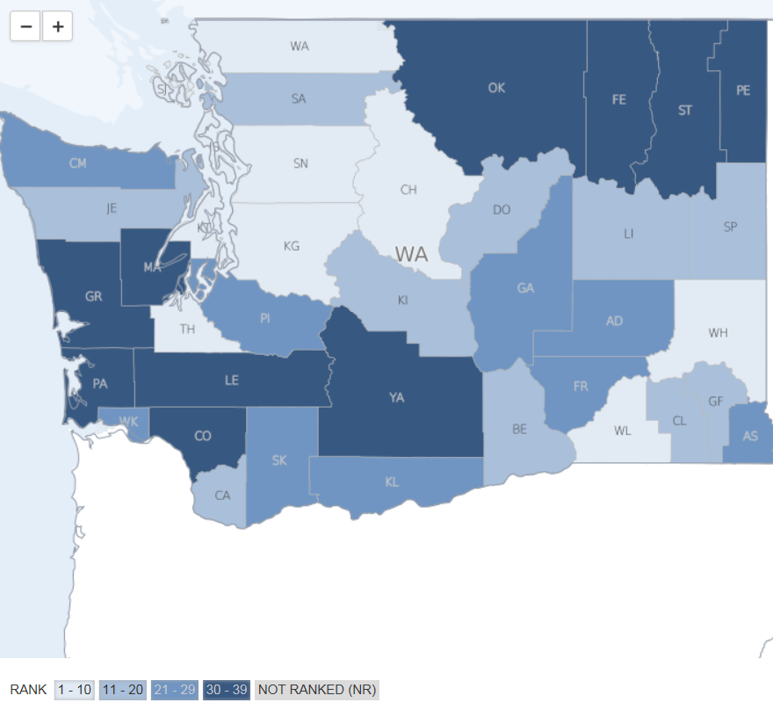
RWJ County Health Rankings for San Juan County
Ranking out of 39
2014 | 2016
#3 | #3
Health Factors, include health behaviors, clinical care, social and economic factors and physical environment

Slide 21
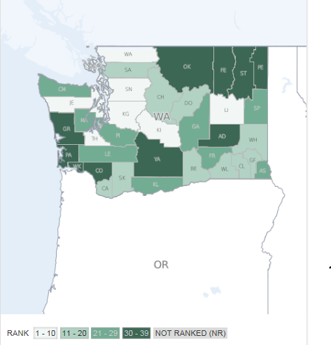
Ranking out of 39
2014 | 2016
#1 | #1
The ranks are based on two types of measures: how long people live and how healthy people feel while alive.

Slide 22
2014 CHNA: Needs, Potential Disparities and Opportunities Identified through Community Leader Key Informant Interviews
Needs & Opportunities / Qualitative

Slide 23
Areas for Improvement / 2014 CHNA
Health promotion and disease prevention – improving communication with residents about available resources and increasing immunization rates.
Care coordination – helping residents navigate the health care system and identify those in need of additional support (elderly and patients with complex medical needs), as well as end-of-life care.
Behavioral health – improving access to mental health and substance abuse treatment and prevention services.

Slide 24
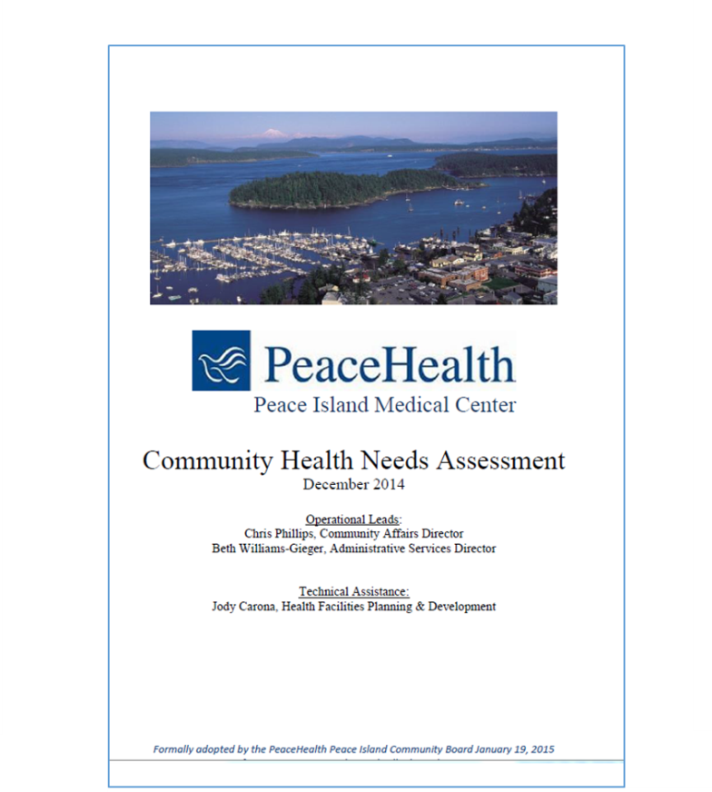
2014 CHNA Priorities & Implementation Approach
Increase immunization rates.
Increase access to behavioral health services.
Meet the psycho-social and medical needs of higher risk patient populations, e.g. frequent users of EMS and ED services, and people with chronic or end-of-life illness.
Create a resource guide
Develop community health consortium in partnership with Health Department to advance implementation strategies.
Notes:
The last time we reported to the Board of health we outlined the priorities noted in the 2015 CHNA and described the development of the community health consortium.

Slide 25
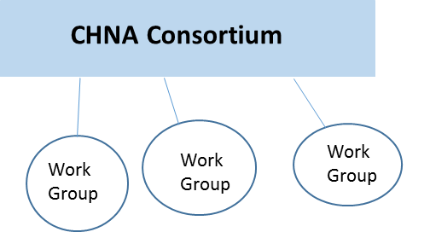
Community Health Improvement Consortium
Consortium was co-convened by PeaceHealth and County Health Department in May 2015 for the purpose of implementing the CHNA objectives.
Participants include:
  PeaceHealth and County Health Department
  Family Resource Centers
  Compass Health
  Community Foundation
  EMS
  Hospital District #1
  Planned Parenthood
  Hospice
  Other

Slide 26
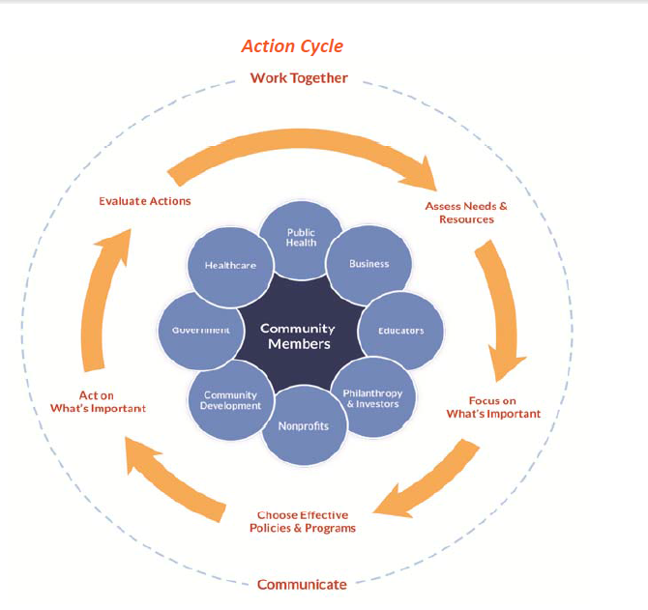
Plan to build the Consortium
Secure resources
Build more specific action plans
Delineate clear measures of success / metrics
Communicate progress to the PIMC Board and community partners on an ongoing basis.

Slide 27
Progress Reports on Consortium Focus Areas
Immunization rates
Resource guide
Behavioral health access
Care coordination / seniors and people with chronic or end-of-life illness

Slide 28



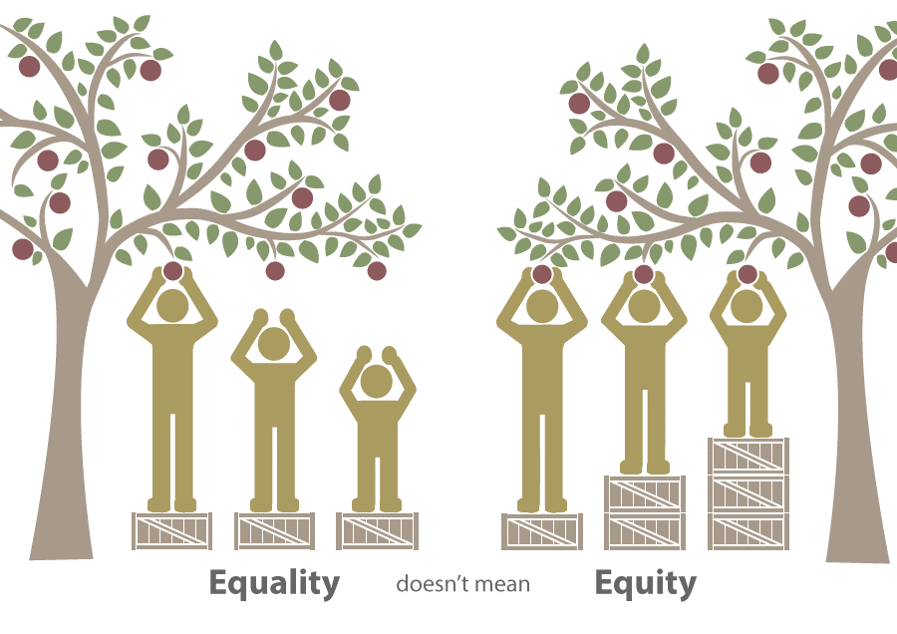
CHNA 2016 Architecture
Pillars & Focus Areas
Mostly carried over from 2013 CHNA
Lots of overlap
 | Healthy, Active Living | Child & Family Wellbeing | Health Delivery Systems | Equity
Focus Areas | Physical activity, places to play Tobacco, alcohol and other drugs Healthy eating Social networks | Maternal-child health Adverse childhood events (ACEs) and family resiliency | Access to quality, affordable medical, behavioral health and dental services Respectful, culturally-appropriate care | People who are homeless Ethnic/racial populations Specific urban neighborhoods and rural communities
Notes:
We want to start with a refined CHNA framework (carried over 2013) and then share what we have learned from updated data and a set of key informant interviews.
Address issue of overlap

Slide 29
Significant Gaps and Opportunities Discussion
Breakup into small groups
Discuss the question: Are there significant gaps or opportunities the Consortium should consider?
Report on top three or so at the table
Notes:
We want to start with a refined CHNA framework (carried over 2013) and then share what we have learned from updated data and a set of key informant interviews.
Address issue of overlap

Slide 30

Summary & Next Steps

Slide 31
Thank you

