Slide 1
San Juan Community Health Consortium Update
February 2016

Slide 2
CHNA Priorities & Implementation Approach
Increase immunization rates.
Increase access to behavioral health services.
Meet the psycho-social and medical needs of higher risk patient populations, e.g. frequent users of EMS and ED services, and people with chronic or end-of-life illness.
Create a resource Guide
Develop community health consortium in partnership with Health Department to advance implementation strategies

Slide 3
SJC Community Health Consortium - Initial Participants
Name
Organization
Barbara LaBrash
Health and Community Services, San Juan County
Beth Helstien
San Juan Library
Beth Williams Gieger
Peace Island Medical Director
Carrie Unpingco
Community Foundation
Chris Phillips
PeaceHealth NWN
Ellen Wilcox MSW, MPH
Health and Community Services, San Juan County
Jennifer Armstrong
SJI Family Resource Center
Lenore Bayuk
San Juan Hospital District
Linda McCarthy
Planned Parenthood
Mariluz Villa, M.D.
Hospice
Mark Tompkins
Health and Community Services, San Juan County
Michael Edwards- DDS, MD, FACS
San Juan Hospital District
Sanjay Rughani
Staff (PeaceHealth)

Slide 4
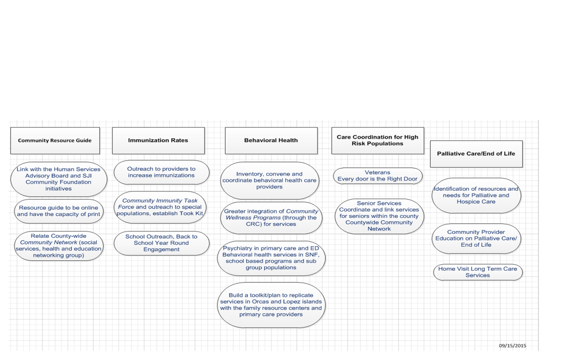
Work Groups & Objectives

Slide 5
Next Steps
San Juan Community Health Consortium will continue to move forward on the initiatives identified in the Community Health Needs Assessment without a dedicated Peace Health program coordinator.
Each Workgroup has identified a chair and/or co-chair for the subcommittee work. The chairpersons are responsible to convene meetings, document progress and report back to the Consortium.
The Consortium will continue to work towards building collaborative partnerships in San Juan County.

