Slide 2
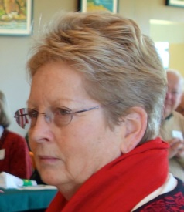
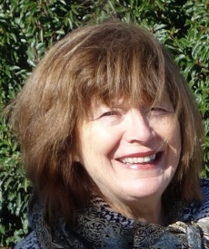
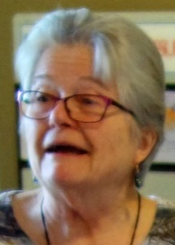
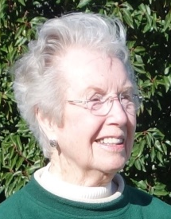
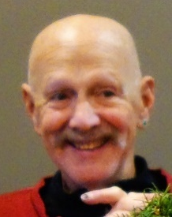
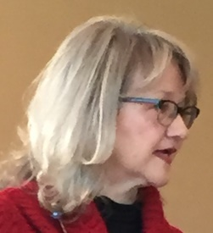
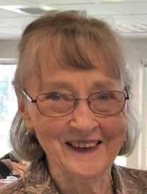

Slide 3
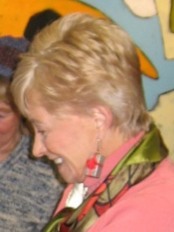
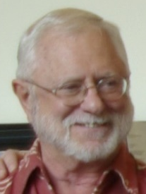
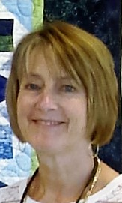
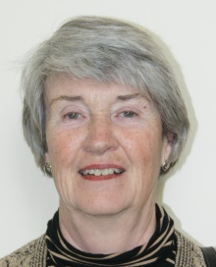
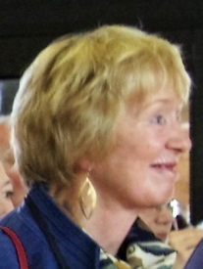
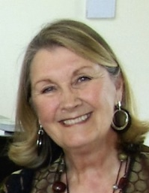
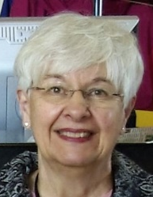
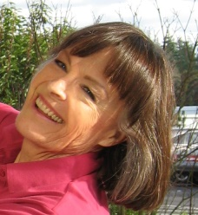
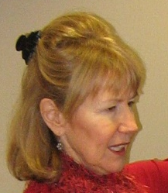

Slide 4
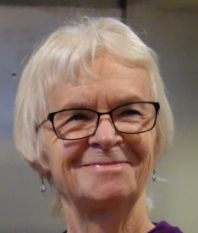
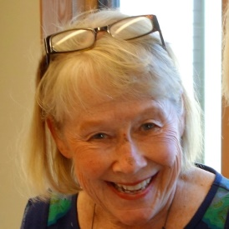
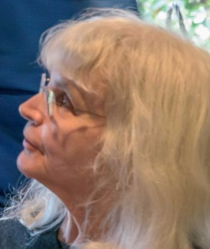
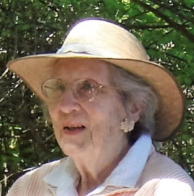
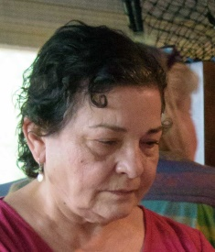
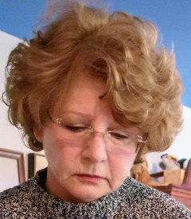
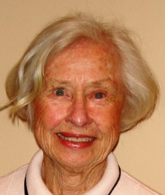
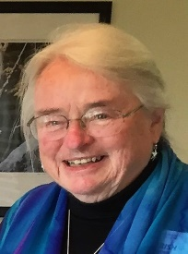
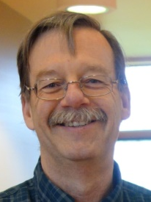

Slide 5
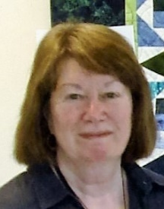
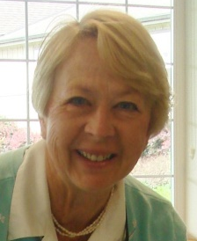
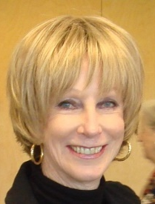
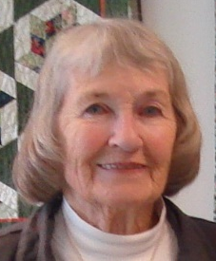
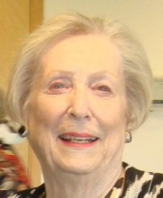
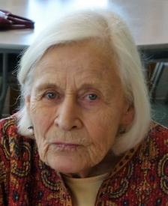
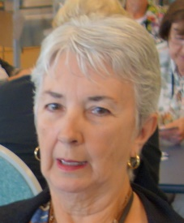
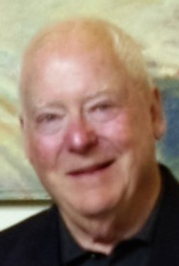
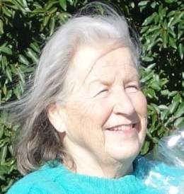

Slide 6
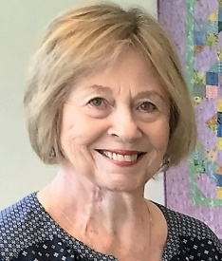
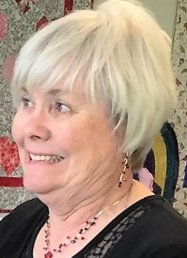
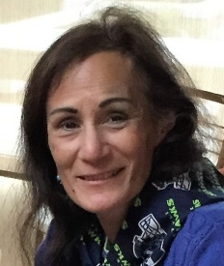
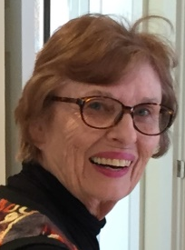
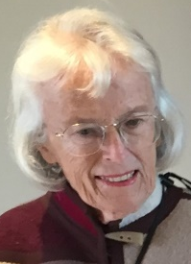
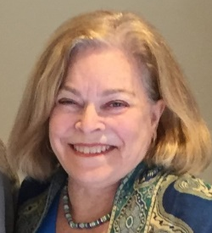
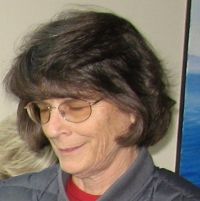
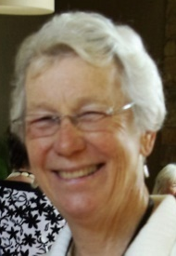
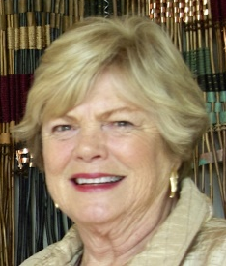

Slide 7
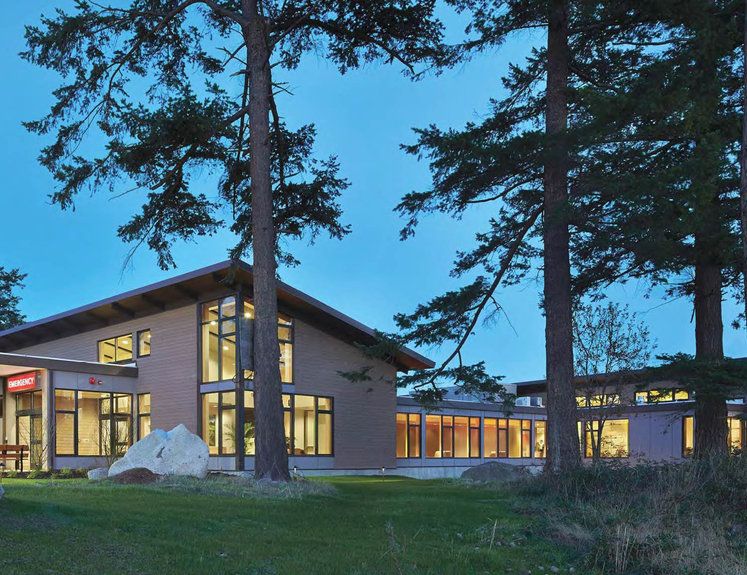
Supports patients and staff at Peace Island Medical Center

Slide 8
Projects

Slide 9
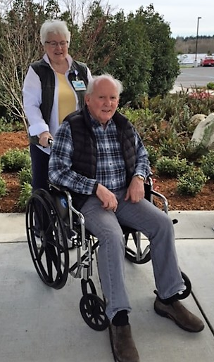
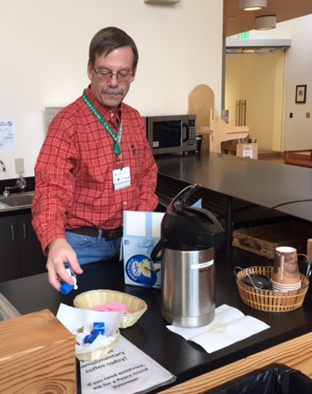
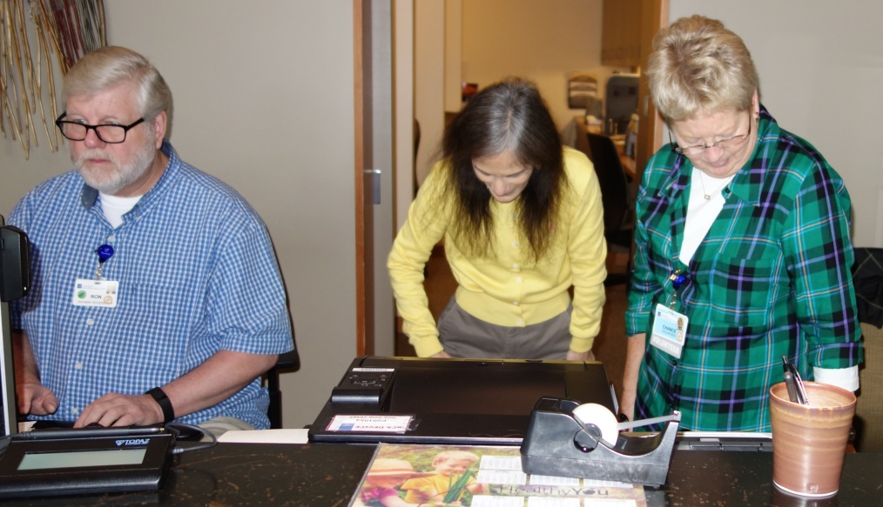
In House Volunteers
Notes:
Slide will appear with just the picture of Diana and Tom. The other two will come in one at a time when you click.

Slide 10
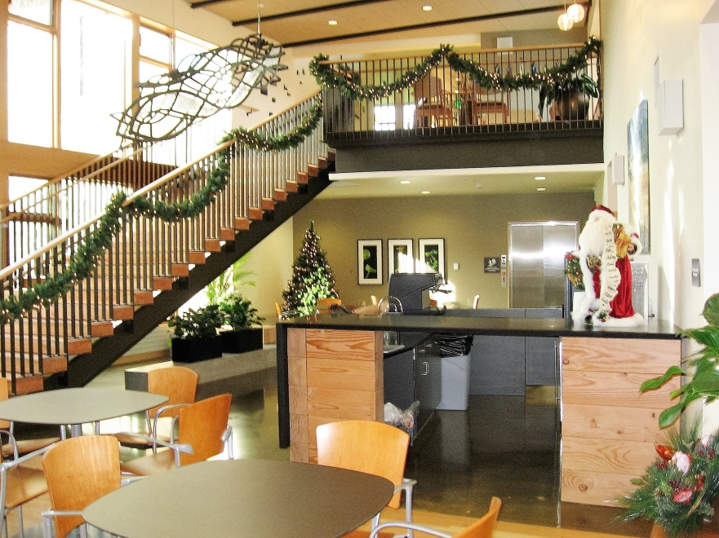
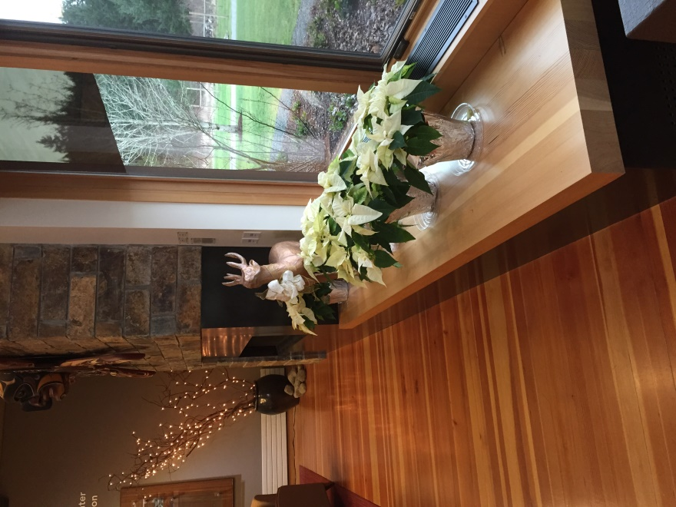
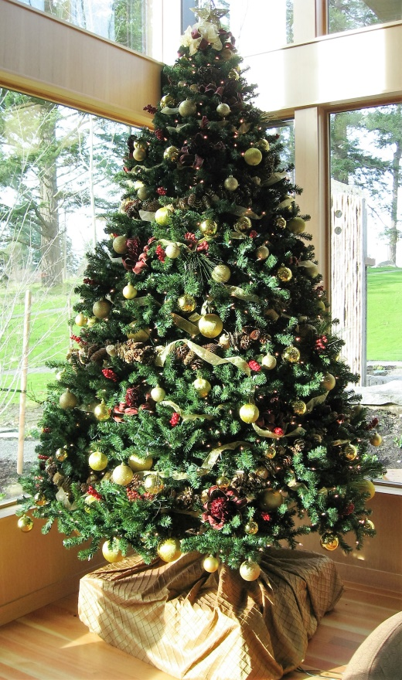
Holiday Decorations
Notes:
Slide will appear with just the picture of Margherita. Choir boys will appear when you click.

Slide 11
Holiday Decorations

Slide 12
Holiday Decorations

Slide 13
Holiday Decorations
Notes:
Slide will appear with just the picture of the tree. Poinsettias will appear when you click.

Slide 14
Holiday Decorations

Slide 15
Judges for Poster Contest

Slide 16
PIMC Hostesses
Notes:
Slide will appear with just the largest photo of several plate of cookies. The other pictures will appear one at a time when you click.

Slide 17
Chemo Comfort Kits

Slide 18
Cancer Care Hats, Lap Robes, Mitts
Notes:
Slide will appear with just the quilts. Hats will appear when you click.

Slide 19
Angel Fund
Notes:
Slide will appear with just the ferry logo. Other items will appear one at a time when you click.

Slide 20
Stuffies
Notes:
Slide will appear with just the cute little guy. Other pictures will appear one at a time when you click.

Slide 21
Blood Pressure Kiosk & Peace Path
Notes:
Slide will appear with just Tom. Other 2 pictures will appear one at a time when you click.

Slide 22
Magazines, Picnic Table, Keurig, Microwave
Notes:
Slide will appear with just Tom. Other 2 pictures will appear one at a time when you click.

Slide 23
Fundraising

Slide 24
Dues, Donations & Time
Notes:
I thought this was the best way to show donations and dues—they both come from our “people”. This slide will appear with all faces showing.

Slide 25
Easter Basket Sales
Notes:
Slide will appear with just the large basket. Other pics will appear one at a time when you click.

Slide 26
Fundraising Events
Notes:
Slide will appear with just the bottom photo. Small photo will appear when you click.

Slide 27
Mini Christmas Tree Silent Auction
Notes:
Slide will appear with just the bottom row of trees. Other pics will appear one at a time when you click.

Slide 28
Christmas Stockings Silent Auction
Notes:
Slide will appear with both photos showing.

Slide 29
Christmas Cookies Sales
Notes:
Slide will appear with just the large picture. Other photos will appear one at a time when you click.

Slide 30
Concours d’Elegance Muffins & Coffee

Slide 31
Fundraising Events
Notes:
Slide will appear with just the bottom photo. Top photo will appear when you click.

Slide 32
Fundraising Events

Slide 33
Looking
Forward

Slide 34
Notes:
You can tell I like this slide—it shows that we are a group of people who care about PIMC. This slide will appear with all photos showing. I thought it would be a good one to show where we are going.

