Slide 1
Initial Logo Choices from Anne Francis

Slide 2
Incorporating Commissioner comments, Anne and I refined the logo to this …
Same logo – different sizes and layouts for different uses.

Slide 3
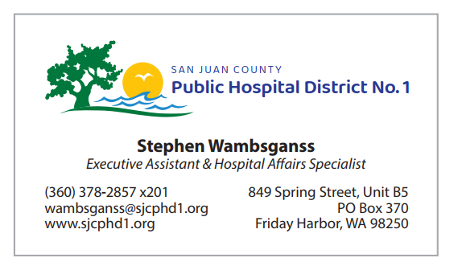
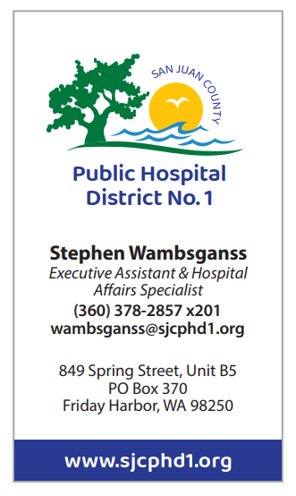
Examples of how the logo could be used …
Business Cards …

Slide 4
Examples of how the logo could be used …
Letterhead …
Email Signature …
Stephen Wambsganss
Executive Assistant and Hospital Affairs Specialist
San Juan County Public Hospital District #1
P.O. Box 370, 849 Spring Street, Unit B-5
Friday Harbor, WA, 98250
Office: (360) 378-2857, Ext. 201
Fax: (360) 378-3583
wambsganss@sjcphd1.org
swambsganss@sanjuanems.org
www.sjcphd1.org

