Slide 1
Peace Island Medical Center
Reporting Period January 1,2021 through June 30, 2021

Slide 2
Semi-Annual Report to San Juan County Public Hospital District #1 Board of Commissioners.

Slide 3
Number of Patients Served

Slide 4
Patient Origin by Zip Code 98250
89 % of the patients served at PIMC are district residents - 98250
7 % of the patients are from other zip codes in San Juan County (Orcas, Lopez, Shaw)
4 % are from outside of San Juan County.

Slide 5
Health Services Provided at PIMC
Primary Care with Peace Health Medical Group
24/7 Emergency Department Services
Integrated Behavioral Health Program
Visiting Specialty Care
Outpatient Cancer Care and Infusion Services
Outpatient Surgical Services
Diagnostic Imaging & Laboratory Services
Outpatient Physical Therapy Services
Professional Pharmacy Services

Slide 6
Number and Type of Clinical Providers at PIMC - Updates
Primary Care : Kristen Rezabek, Registered Dietician twice a month, Megan Whitzell, RN Diabetic Educator once a month. Certified wound care RN weekly.
Emergency Dept: Six UW Emergency Medicine Residents scheduled for summer rotation June-Sept.
Cancer Care: Dr. Reissman acting PIMC Oncology medical director until August when Dr. Drew Murray is hired.
Specialty Care: visiting pediatricians, Dr. Amy Haley and Dr. Manny Eusibio – 2 Friday’s a month.

Slide 7
COVID-19 Update
Dedicated COVID-19 PeaceHealth site in alignment with current CDC guidelines, federal and state regulations.
Policies and other resources readily available to staff to ensure safety of staff, patients, and visitors, updated accordingly to current guidelines.
Single-point entrance process for staff, patients, and visitors continues successfully.
Includes process for those that need be seen that have symptoms.
Onsite drive-up testing a success!
Vaccine clinics for staff and members of the community.
Continued partnership with San Juan County Public Health Dept.
No hospital-acquired COVID-19 infections have occurred with efforts and focus.

Slide 8
Quality Measures and Performance (cont.)
PeaceHealth Peace Island is currently working to implement system Clinical excellence initiatives and subsequent quality measures such as:
Bio-Vigil Hand Hygiene Electronic Monitoring System
Mortality Reduction Work
PIMC is meeting mortality metric goals and has been for over a year. This work is being done with the entire PeaceHealth system. There will be more to report on as this work continues amidst COVID-19 on the next Quality Report!

Slide 9
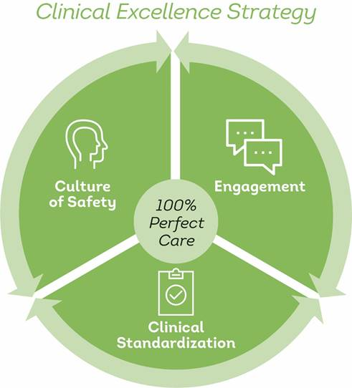
Clinical Excellence Initiatives
PeaceHealth Peace Island, in alignment with the PeaceHealth System, has continued to focus on the following clinical excellence (Quality) initiatives:
Safety STOP
Catheter Associated Urinary Tract Infections (CAUTI)
Central Line Associated Blood Stream Infections (CLABSI)
Procedural Safety (Time Out process)
Preventing Falls with Serious Injury
Safety Absolutes (Accurate Patient Identification)
Code Sepsis (Deferred do to low volumes)
Hand Hygiene (Bio-Vigil system implementation, Fall 2021)

Slide 10
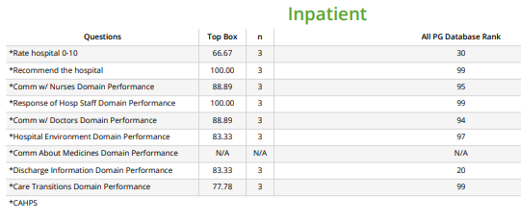
Inpatient Experience Overview (January – June 2021)
Between January 1st and June 30th we only received 3 inpatient surveys. We need at least 30 returned surveys to be able to validate the data as statistically significant.
ALL PG DB= All Inpatient Hospital client surveys returned for all hospitals in the entire Press Ganey Database.
n=Number of surveys returned
Top Box Score= patients who answered “always”, “strongly agree” or “9-10” on Rate Hospital question.
Top Box Percentile Rank= what percentile PIMC ranks against all Press Ganey hospitals in the nation for top box score.
Notes:
RN Communication
-nurses treated you with courtesy/respect
-listen carefully
-explain things in a way you can understand

Slide 11
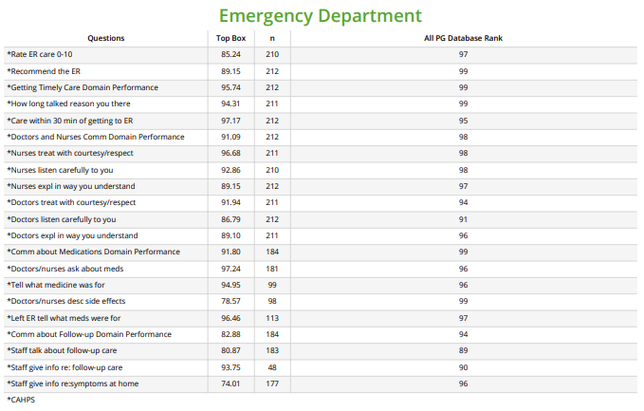
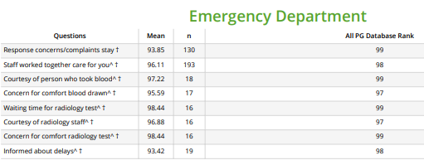
Emergency Department Overview (January – June 2021)
CAHPS
PIMC ED continues to be in upper 90th percentile in patient experience!
In July 2020 PeaceHealth shortened the Emergency Survey, removing most Press Ganey questions, except for those below, and only asking the CAHPS questions (Consumer Assessment of Hospital and Provider Systems).
As of Jan 2021, the CAHPS survey became official in the eyes of CMS (Center for Medicare and Medicaid Services).
Added Questions by Mean Score
Top Box = scoring that counts only the highest responses
n=Number of surveys returned
ALL PG DB= All Emergency Services client surveys returned for all hospitals in the entire Press Ganey Database.

Slide 12
Summary Financial Report
Notes:
Summary – Subtotals.

Slide 13
Patient/Family Comments received January – June 2021
Exceptional professionalism & standard of patient care. Every nurse, staff member & Dr. Pietro made me feel comfortable, informed & well cared for. My experience day of surgery, observing their interactions as a team, was top notch. Couldn't imagine it being better in any way. Thank you! (OAS)
The ER team was great! Very friendly & caring people. Dr. Lopez was pleasant, competent and helped me with no pain. (ED)
This is my third trip to the Peace Island Emergency room. I have yet to have a bad experience. I view our ER as top-notch, and on par with any other hospital I have been to. (ED)
Dr. Perez is a wonderful doctor & related well to my Cardiology staff & made sure I had the upcoming tests I needed. (ED)
On vacation on the beautiful island of San Juan. So very grateful to *Dr. Perez and the staff. Best ER experience ever! (ED)
The nurse and doctor were very attentive, listened closely to my problem and answered all my questions. (ED)
The BEST team to date - TOP NOTCH care from the Emergency Department staff!! (ED)
Doctor took the time to listen - very nice man. Nurses were excellent! (OAS)
Thank you for taking it seriously even though I wasn't in extreme danger. I appreciate the care and felt very relaxed in the environment. (ED)
The attention and care I received was extraordinary. I wouldn't have changed a thing. Cari Matthews was particularly wonderful. (ED)
The care was excellent, and the food was simple but perfect. I didn't want much, and I'm a vegan. The staff was able to accommodate me, and I was pleasantly surprised. (IP)
IP= Inpatient ED= Emergency OAS= Outpatient Ambulatory Surgery

Slide 14
Revenue & Deductions
Notes:
Revenue with Deduction detail

Slide 15
Expense Detail
Notes:
Expense detail

Slide 16
Notes:
Alternate Layout

Slide 17
Conclusions of the six-month report:
On healthcare services covered by the subsidy (Charitable Services, Emergency Department and Physician Services) the estimated six-month loss, without the subsidy, is -$6,705,859. With an estimated tax subsidy of $516,838, the loss is reduced to -$6,189,020".
Total PeaceHealth services provided for the same period, resulted in a positive margin of $857,593 or, 6.78% with the subsidy, and a positive margin of $340,755 or, 2.69% without the subsidy.

