Slide 1
Community Survey Results and Implications for Senior Service Programming
September 23, 2019

Slide 2
In late 2018, the Inter Island Healthcare Foundation retained HFPD to support it in undertaking a feasibility study related to the development of a sustainable community-based long-term care delivery system in the County.
As part of its work, HFPD conducted a community survey of County residents that are either age 70+ or serve as a caregiver to an elderly resident.
The survey was designed to assess:
County residents’ health care use patterns and awareness of, and preference for, community based long term care services.
Program and service needs and gaps.
The survey was conducted from August 14, 2019 to September 15, 2019, and a total of 444 surveys were undertaken, of which 393 were deemed “complete” for purposes of analysis.

Slide 3
The survey tool:
The survey was initially drafted by HFPD and input was provided by the Foundation.
The survey was conducted/distributed in three ways:
Phone survey: HFPD purchased land line phone numbers for persons aged 70+ in the zip codes comprising San Juan County, and calls were made throughout the day over the course of approximately 3 weeks.
Online survey: The Foundation advertised the survey and directed persons to an online link on the Inter Island Healthcare Foundation’s website as well as on San Juan County Public Hospital District #1’s website. Individuals attending the fair were also provided information about the on-line survey.
Paper Surveys: Hard copies of the survey were distributed during the San Juan County Fair and persons were offered two ways to return them: 1) drop boxes located at a number of locations throughout the County; or 2) mailed (in self-addressed stamped envelopes) to HFPD.

Slide 4
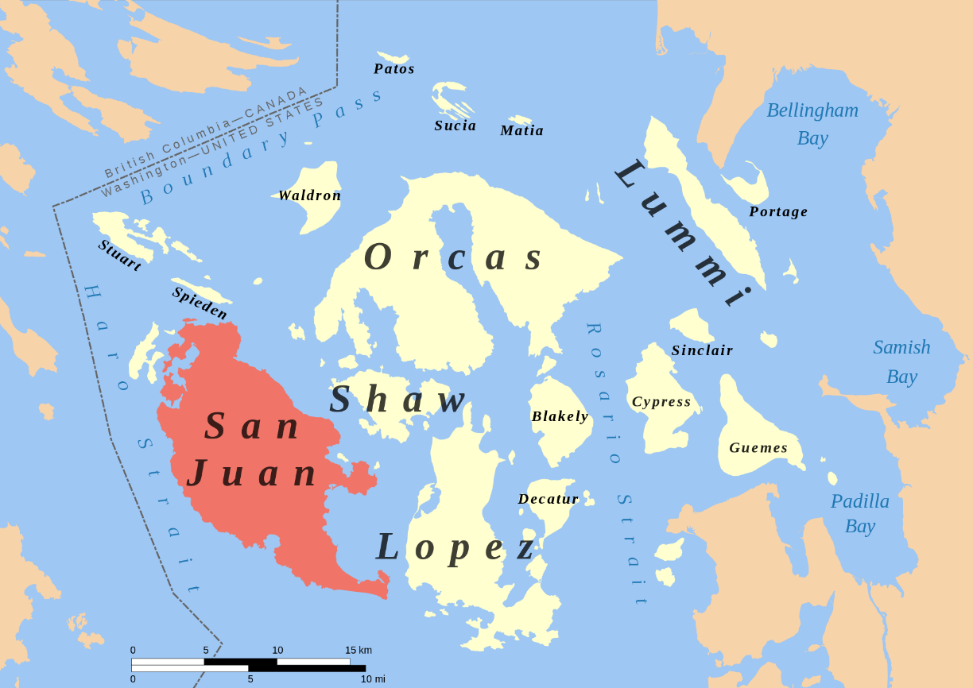
For purposes of the survey, data from San Juan County and its islands were collected from 7-of-8 zip codes. Although the island was surveyed, no responses were recorded from Blakely Island.
The survey area included the following zip codes:
San Juan Island:
Friday Harbor (98250)
Roche Harbor (98250)
Orcas Island:
Deer Harbor (98243)
Eastsound (98245)
Olga (98279)
Orcas (98280)
Lopez Island (98261)
Shaw Island (98286)
Blakely Island (98222)
San Juan Island. (2019, September 13). Retrieved from https://en.wikipedia.org/wiki/San_Juan_Island#/media/File:San_Juan_Island_locator_map.svg

Slide 5
Of the 444 surveys, 24 respondents were excluded because they did not provide a zip code or otherwise indicated they resided outside of the County. Another 27 were excluded because they did not meet criteria regarding age or caregiver status. 393 surveys were deemed complete and used in analysis.
Collection Method | No. of surveys initiated | No. of surveys excluded because no zip code provided OR did not reside in the County | No. of surveys excluded because respondent did not meet survey criteria (not a caregiver or not over age 70) | Completed surveys
Inter Island Foundation on-line link | 39 | 2 | 2 | 35
San Juan PHD #1 Online link | 120 | 8 | 1 | 111
Paper Surveys (Fair, library, dropboxes, etc.) includes surveys mailed directly to HFPD | 170 | 7 | 16 | 147
Phone Survey | 115 | 7 | 8 | 100
Total | 444 | 24 | 27 | 393

Slide 6
Of the completed surveys 76% were from persons over the age of 70, another 10% were over the age of 70 and a caregiver and 14% were caregivers under the age of 70.
Q #1: Please tell us how you meet the survey criteria?
Survey respondents by island parallels distribution total residents age 70+
Survey criteria | San Juan | Orcas | Lopez | Shaw | No specific zip code, but resident of San Juan County | Total
Respondent age 70+ | 153 | 81 | 51 | 6 | 8 | 299
Respondent is 70+ and a caregiver | 14 | 14 | 8 | 2 | 2 | 40
Respondent is a caregiver | 34 | 14 | 3 | 0 | 3 | 54
Total | 201 | 109 | 62 | 8 | 13 | 393
51% of completed surveys were from San Juan Island (which accounts for 57% of 70+ in the County)
Orcas represented 28% of completes and is 33% of the County population
Lopez represents 16% of completes and 18% of County population
Shaw represents 2% of completes and 1.5% of County population
Note: throughout the survey the “n”’ from Shaw and to a lesser extent Lopez are low, and could skew responses

Slide 7
Virtually all respondents reported that they were full time residents of San Juan County; this was consistent across the Islands. 80% have resided in the County for more than 11 years.

Slide 8
Depending upon the Island, 25-37% of respondents reported living alone.

Slide 9
About 29% of respondents reported no health care concerns. Of those with concerns, the top 5 concerns/issues were consistent across the Islands. Importantly, 5 of the 12 listed heath care issues accounted for 2/3 of the concerns.
50% of respondents reported 1-2 health concerns
17% of total respondents reported 3-4 health concerns
5% reported 5+ concerns.
Q #8 What medical issues/concerns do you/they have?

Slide 10
About 66% of survey respondents self-reported good to excellent health and the full ability to live independently; 15% reported poor to marginal or declining health and anticipated need for more services in the near future. Once those with 3+ medical conditions were excluded, the % in good health increased to 76%, ranging from 72% on Orcas to a high of 88% on Shaw.
Q # 9: On a Scale of 1+5, with 5 being excellent health and 1 being frail health, how would you/they rate their health?
 | 1-2 (Poor or Marginal Declining Health) |  | 4-5 (Good Health, Excellent Health)
 | 3+ Conditions | Other Respondents | 3+ Conditions | Other Respondents
San Juan | 47% | 5% | 32% | 81%
Orcas | 39% | 9% | 25% | 72%
Lopez | 31% | 6% | 31% | 78%
Total | 43% | 7% | 30% | 76%

Slide 11
In the rest of this analysis, HFPD compared residents reporting 3+ health issues to those having less than 3. The differences are significant.
The “n” of those with 3+ health issues is 85 (or 22% of all respondents). The “n” of those with 3 or less is 308.

Slide 12
Overall, 94% of surveys completed indicated that they or the person they provided care for has a regular health care provider, and 90% percent indicated that the provider was located in the County.
Respondents reported high rates of having a regular primary care provider. For those with 3+ health care issues, 99% reported a regular provider. Excluding this cohort of respondents, the percentage was 92%.
Respondents also used local primary care, with 90% overall using the provider on the Island on which they or the person they care for resides. For those reporting 3+ health care issues, this rate was 95%.

Slide 13
For those respondents reporting 3+ health issues, respondents were 2X more likely to have had ER visits, 3.5 times more likely to have been hospitalized at least 2x and 1.5x more likely to have needed an ambulance two or more times during the last year. Not surprisingly, they were 6x more likely to report poor or declining health.
Question | San Juan Respondents with 3+ Health Issues | Other San Juan | Orcas Respondents with 3+ Health Issues | Other Orcas | Lopez Respondents with 3+ Health Issues | Other Lopez | All County 3+ Health Issues | Other County Total
Living Situation (Lives with others) | 70% | 68% | 74% | 61% | 46% | 67% | 67% | 66%
ER visits 2+ | 59% | 25% | 33% | 25% | 38% | 23% | 48% | 24%
Hospitalized 2+ | 100% | 15% | 100% | 14% | 100% | 17% | 65% | 19%
Ambulance Needed 2+ | 60% | 13% | 42% | 17% | 50% | 33% | 54% | 36%
Rating of 1-2 (poor health and marginal declining health) | 47% | 5% | 42% | 9% | 31% | 6% | 43% | 7%

Slide 14
Those with 3+ health issues/needs went off (or were transferred off) Island much more frequently for ER care.
3+ conditions and where went for ER
Those with less than 3 issues/conditions
ED Visit Location | San Juan | Orcas | Lopez | Total
Friday Harbor | 42% | 9% | 12% | 28%
Anacortes | 1% | 26% | 12% | 10%
Bellingham | 6% | 14% | 18% | 10%
Other | 51% | 51% | 59% | 52%
Total | 100% | 100% | 100% | 100%
ED Visit Location | San Juan | Orcas | Lopez | Shaw (n=8) | Total
Friday Harbor | 89% | 17% | 7% | 0% | 58%
Anacortes | 0% | 37% | 33% | 25% | 14%
Bellingham | 9% | 21% | 33% | 50% | 17%
Other | 2% | 25% | 27% | 25% | 11%
Total | 100% | 100% | 100% | 100% | 100%
Other included: Mt. Vernon, Whidbey, Seattle, Everett, Non WA, Edmonds

Slide 15
27% of respondents were hospitalized. More patients with 3+ conditions were hospitalized on Friday Harbor, and less in Anacortes, than other respondents.
3+ conditions; where hospitalized.
Those with less than 3 issues/conditions
 | San Juan | Orcas | Lopez | Shaw | Total
Friday Harbor | 24% | 4% | 0% | 0% | 12%
Anacortes | 7% | 26% | 31% | 57% | 20%
Bellingham | 38% | 33% | 23% | 29% | 33%
Other | 31% | 37% | 46% | 14% | 34%
Total | 100% | 100% | 100% | 100% | 100%
 | San Juan | Orcas | Lopez | Shaw (n=8) | Total
Friday Harbor | 14% | 0% | 0% | 0% | 6%
Anacortes | 9% | 25% | 57% | 57% | 27%
Bellingham | 45% | 25% | 29% | 29% | 35%
Other | 32% | 50% | 14% | 14% | 33%
Total | 100% | 100% | 100% | 100% | 100%
Other included: Mt. Vernon, Whidbey, Seattle, Everett, Non WA, Edmonds

Slide 16
27% of respondents were hospitalized. More patients with 3+ conditions were hospitalized on Friday Harbor, and less in Anacortes, than other respondents.
Those with less than 3 issues/conditions
Other included: Mt. Vernon, Whidbey, Seattle, Everett, Non WA, Edmonds

Slide 17
Six services were regularly identified as needed to support respondents to stay at home or in the community. For those with 3+ health care concerns, the top needs were the same, however, home safety check home repair ranked lower and medical and assistance with ADLs ranked higher.
About 13% of all respondents indicated that additional services were needed to remain at home, and 46 % of those with 3+ reported needs.
Other services mentioned as needed included urgent care and memory help (n’s were very small).
Q #16 What additional services do you/they need to remain at home or in the community?

Slide 18
Services are lacking
Q #17: Have you tried to access any of these services in the County?
For respondents that reported having tried to access services, across the County, about 37% reported either not being able to find the service or not being able to find all services needed. This was higher on both Lopez and Orcas Islands (43% and 40%, respectively).
For those with 3+ medical conditions, 50% reported either not able to find the service or not being able to find all services needed; with higher percentages on Lopez and Orcas Islands (100% and 69%, respectively).

Slide 19
For those respondents with 3 conditions, the percentage need state funded Medicaid support was significantly higher on Lopez and Orcas Island in particular.
3+ Conditions
Those with less than 3 issues/conditions
 | San Juan | Orcas | Lopez | Total
Private Pay or out of pocket | 43% | 35% | 0% | 38%
Insurance (commercial and/or long term care insurance) | 25% | 20% | 33% | 25%
I/they would need state funded (Medicaid) support | 15% | 35% | 67% | 23%
Family member would pay | 13% | 5% | 0% | 9%
Other | 5% | 5% | 0% | 5%
Total | 100% | 100% | 100% | 100%
 | San Juan | Orcas | Lopez | Total
Private Pay or out of pocket | 41% | 24% | 27% | 32%
Insurance (commercial and/or long term care insurance) | 30% | 40% | 18% | 30%
I/they would need state funded (Medicaid) support | 22% | 16% | 36% | 25%
Family member would pay | 0% | 4% | 9% | 4%
Other | 7% | 16% | 9% | 9%
Total | 100% | 100% | 100% | 100%

Slide 20
At least 69% of respondents indicated that they were aware of someone having to move off Island due to lack of services in the last several years. Of this group, 30% indicated they knew of 5+ people moving off island.

Slide 21
Key Takeaways:
Survey respondents are long-term residents, and about 75% reside with at least one other person.
A very high percentage of respondents have primary care and the overwhelming majority receive that care on the Island on which they reside.
75% of respondents reported at least one medical issue/concern; however only those with 3 or more issues/concerns (22% of all respondents) are high utilizers of health care and expressed concerns about increasing frailty.
Services are lacking: For respondents that reported having tried to access services, across the County, about 37% reported either not being able to find the service or not being able to find all services needed. This was even more of an issue on Lopez and Orcas , and for those with 3+ medical conditions (50%).
45% of respondents (n=179) indicated a willingness to participate in a focus group and provided contact information.

